Slide 1
Password Generator
Presented by Kazi Zilani

Slide 2
Objectives
Validate software concept and test feasibility
Reduce exposure to risk
Demonstrate usability and user interaction
Gather early feedback and make data driven engineering decision
Gather technical insights to drive later development directions and make informed decisions

Slide 3
System Overview
Key Features
64 character long password using standard pool
Regenerate and copy password
User option to choose password characteristics
Entropy, bit, crack time, and strength indicator

Slide 4
Process & Lifecycle
Process: Waterfall Method
Lifecycle:
  Planning
  Analysis
  Design (Figma Prototype)
  Implementation (Web-Based)
  Testing & Integration
  Maintenance

Slide 5
Scope, Budget, & Risk
The minimum viable product approach
Validating core concepts to keep the budgets low, and initial cost and scope limited
Prevent scope creep

Slide 6
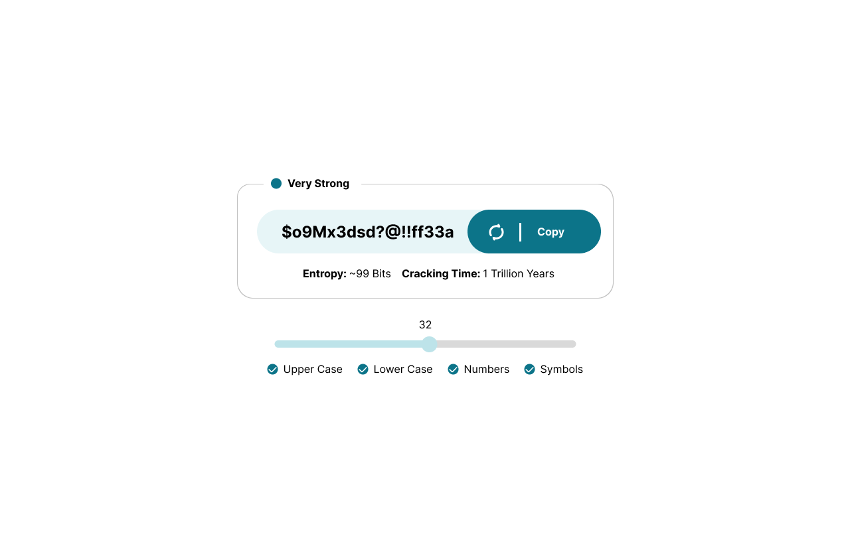
Mockup & Prototype

Slide 7
Conclusion & Recommendation
Responsive design
Reduce load time and increase performance
Add password manager and alert for breach

